Slide 1
Welcome
Boot Camp Session 3

Slide 2
Goals for today
TableView, Delegates, MVC
Demo: MyKitchenExperiments app

Slide 3
Lets refresh our memory!
Objective-C Basics
Memory Management
UITabBar
UINavigation
Gestures

Slide 4

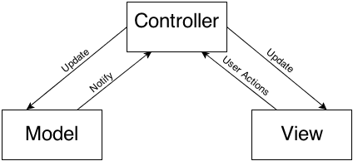
Model View Controller
Model View Controller (MVC) is one of the building blocks of Cocoa and is undoubtedly the most-used design pattern of all. It classifies objects according to their general role in your application and encourages clean separation of code based on role.
Model: The object that holds your application data and defines how to manipulate it. For example, in your application the Model is your Album class.
View: The objects that are in charge of the visual representation of the Model and the controls the user can interact with; basically, all the UIViews and their subclasses. In your application the View is represented by your AlbumView class.
Controller: The controller is the mediator that coordinates all the work. It accesses the data from the model and displays it with the views, listens to events and manipulates the data as necessary. Can you guess which class is your controller? That’s right: ViewController.

Slide 5
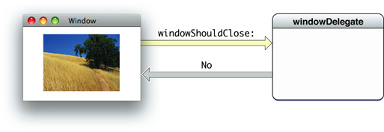
Delegate Design Pattern
Delegation, is a mechanism in which one object acts on behalf of, or in coordination with, another object.
For example, when you use a UITableView, one of the methods you must implement is tableView:numberOfRowsInSection:.
The UITableView object does its job of displaying a table view. However, eventually it will need some information that it doesn’t have. Then, it turns to its delegates and sends a message asking for additional information.
Notes:
You can’t expect the UITableView to know how many rows you want to have in each section, as this is application-specific. Therefore, the task of calculating the amount of rows in each section is passed on to the UITableViewDelegate. This allows the UITableView class to be independent of the data it displays.

Slide 6
Protocols: Delegates in Action
A class interface declares the methods and properties associated with that class. A protocol, by contrast, is used to declare methods and properties that are independent of any specific class.
The basic syntax to define a protocol looks like this:
@protocol ProtocolName
// list of methods and properties
@end
Protocols can include declarations for both instance methods and class methods, as well as properties.
A class can declare optional and required methods through a protocol.

Slide 7
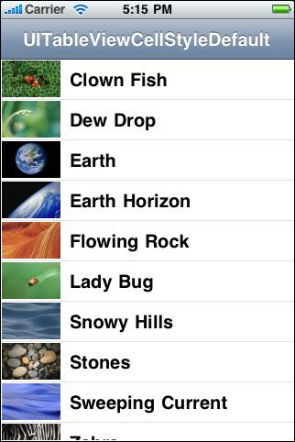
UITableView
A list of items in a single column.
subclass of UIScrollView, which allows users to scroll through the table, (vertical scrolling only)
The cells comprising the individual items of the table are UITableViewCell objects; UITableView uses these objects to draw the visible rows of the table. Cells have content—titles and images—and can have, near the right edge, accessory views.
Table views can enter an editing mode where users can insert, delete, and reorder rows of the table.
A table view is made up of zero or more sections, each with its own rows. Sections are identified by their index number within the table view, and rows are identified by their index number within a section. Any section can optionally be preceded by a section header, and optionally be followed by a section footer.

Slide 8
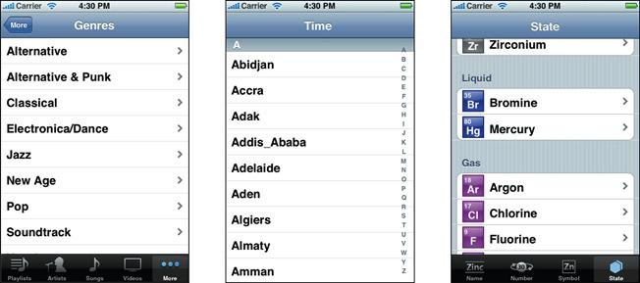
UITableView Styles
Plain
Indexed
Grouped
Notes:
• When you create a UITableView instance you must specify a table style, and this style cannot be changed. In the plain style, section headers and footers float above the content if the part of a complete section is visible. A table view can have an index that appears as a bar on the right hand side of the table (for example, "A" through "Z"). You can touch a particular label to jump to the target section. The grouped style of table view provides a default background color and a default background view for all cells. The background view provides a visual grouping for all cells in a particular section. For example, one group could be a person's name and title, another group for phone numbers that the person uses, and another group for email accounts and so on. See the Settings application for examples of grouped tables. Table views in the grouped style cannot have an index.

Slide 9
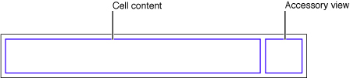
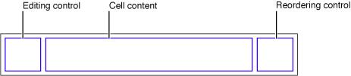
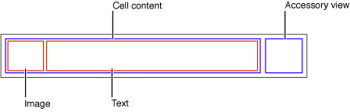
UITableViewCell
The UITableViewCell class defines the attributes and behavior of the cells that appear in UITableView objects.
This class includes properties and methods for setting and managing cell content and background (including text, images, and custom views), managing the cell selection and highlight state, managing accessory views, and initiating the editing of the cell contents.
When creating cells, you can customize them yourself or use one of several predefined styles.
To use a cell with a predefined style, initialize it using the initWithStyle:reuseIdentifier: method or configure the cell with that style in Xcode.
To set the text and images of the cell, use the textLabel, detailTextLabel, and imageView properties.
Notes:
Whether you use a predefined or custom cell, you can change the cell’s background using the backgroundView property or by changing the inherited backgroundColor property. In iOS 7, cells have a white background by default; in earlier versions of iOS, cells inherit the background color of the enclosing table view. If you want to change the background color of a cell, do so in the tableView:willDisplayCell:forRowAtIndexPath: method of your table view delegate.

Slide 10



Standard accessory views
Disclosure indicator—UITableViewCellAccessoryDisclosureIndicator. You use the disclosure indicator when selecting a cell results in the display of another table view reflecting the next level in the data model hierarchy.
Detail disclosure button—UITableViewCellAccessoryDetailDisclosureButton. You use the detail disclosure button when selecting a cell results in a detail view of that item (which may or may not be a table view).
Checkmark—UITableViewCellAccessoryCheckmark. You use a checkmark when a touch on a row results in the selection of that item. This kind of table view is known as a selection list, and it is analogous to a pop-up list. Selection lists can limit selections to one row, or they can allow multiple rows with checkmarks.

Slide 11
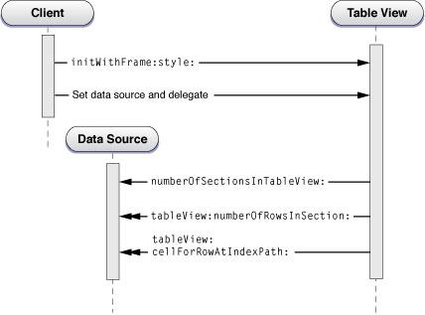
UITableViewDelegate
A UITableView object must have an object that acts as a data source and an object that acts as a delegate;
The data source must adopt the UITableViewDataSource protocol and the delegate must adopt the UITableViewDelegate protocol.
The data source provides information that UITableView needs to construct tables and manages the data model when rows of a table are inserted, deleted, or reordered.
The delegate manages table row configuration and selection, row reordering, highlighting, accessory views, and editing operations.
Notes:
- (UITableViewCell *)cellForRowAtIndexPath:(NSIndexPath *)indexPath
- (NSInteger)numberOfRowsInSection:(NSInteger)section
- (NSInteger)numberOfSectionsInTableView:(UITableView *)tableView
- (void)tableView:(UITableView *)tableView didSelectRowAtIndexPath:(NSIndexPath *)indexPath
: Required methods

Slide 12
MyKitchenExperiments Project
1. List your favorites recipes with image.
2. After clicking on recipe, it will open a new page in the navigation controller and show the details of recipe including pictures, ingredients, procedure, cooking time etc.
3. It will also show a url from yummly. Once you click on it, it will open a webview.

Slide 13
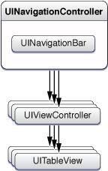
Project View Hierarchy

Slide 14
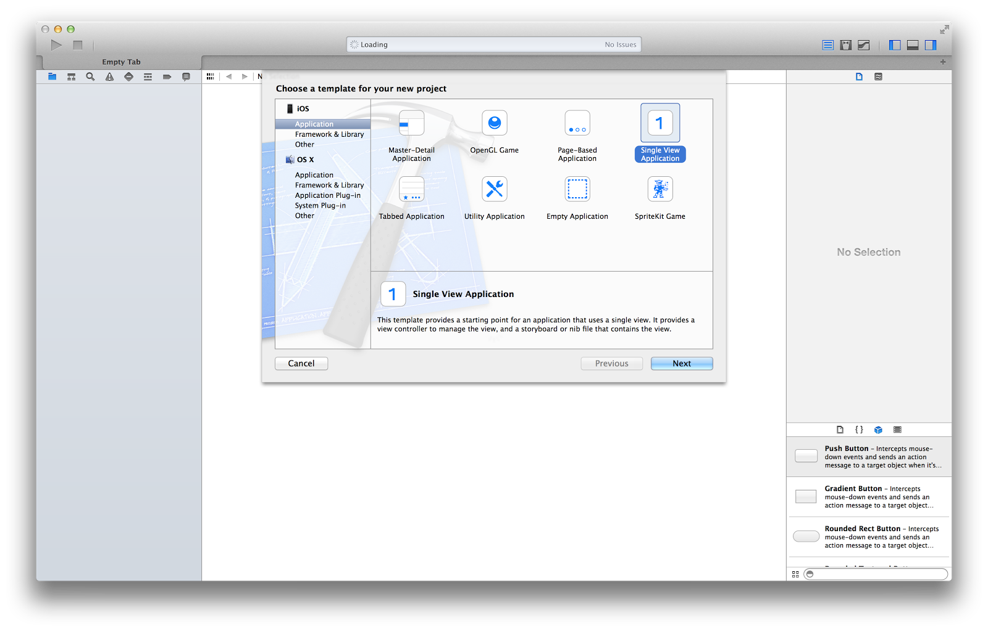
Create Project

Slide 15
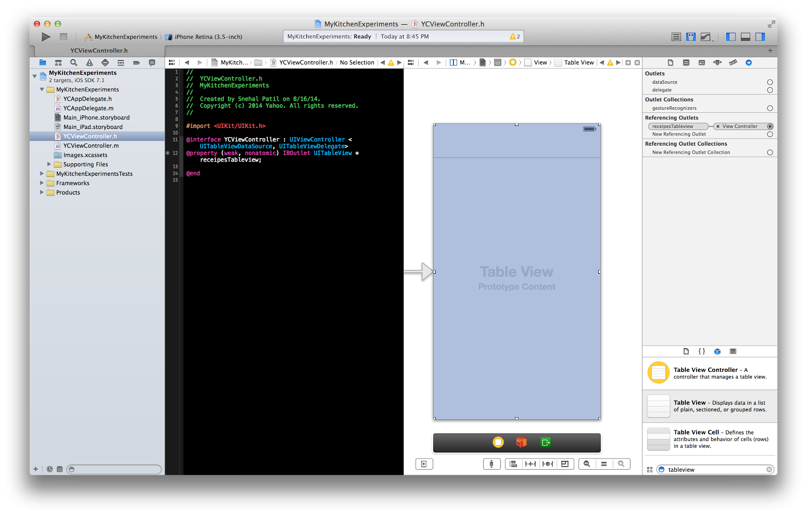
Add Tableview

Slide 16
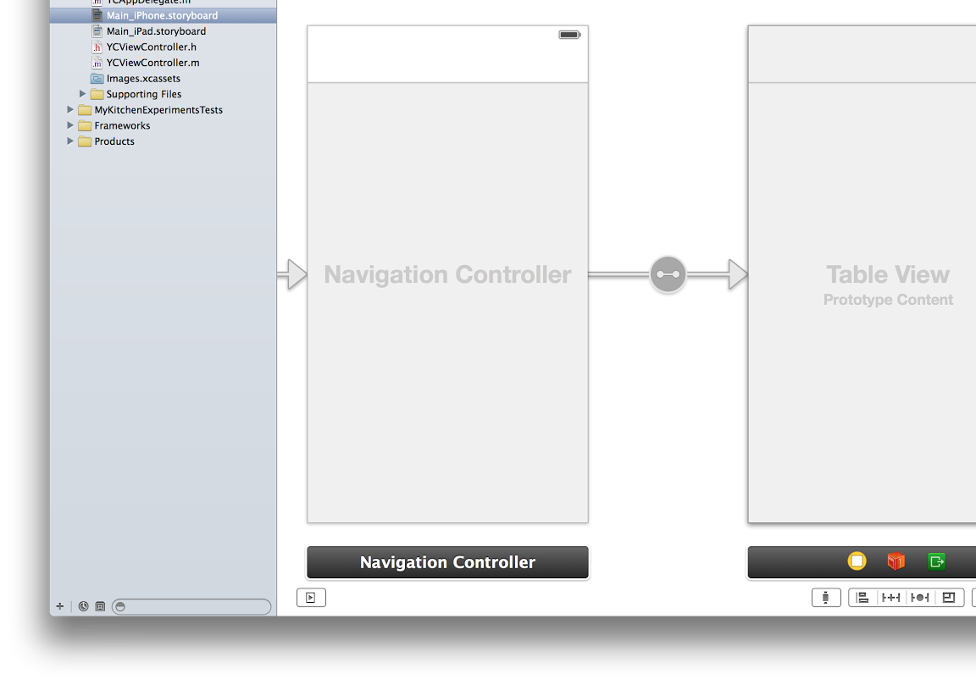
Add Tableview in the Navigation Controller

Slide 17
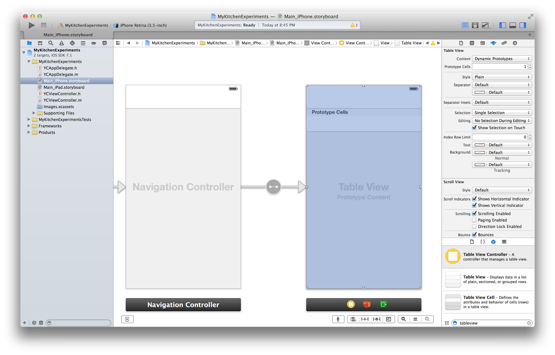
Tableview Properties

Slide 18
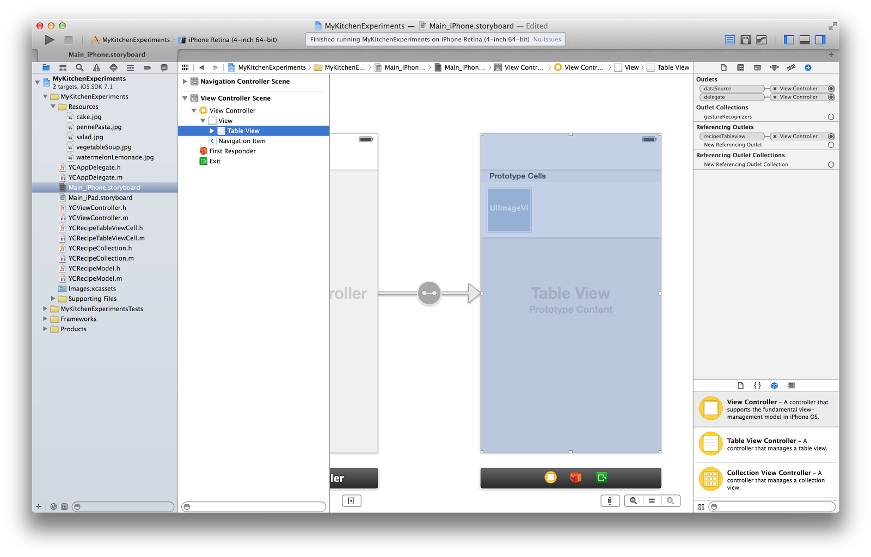
UItableview connections

Slide 19
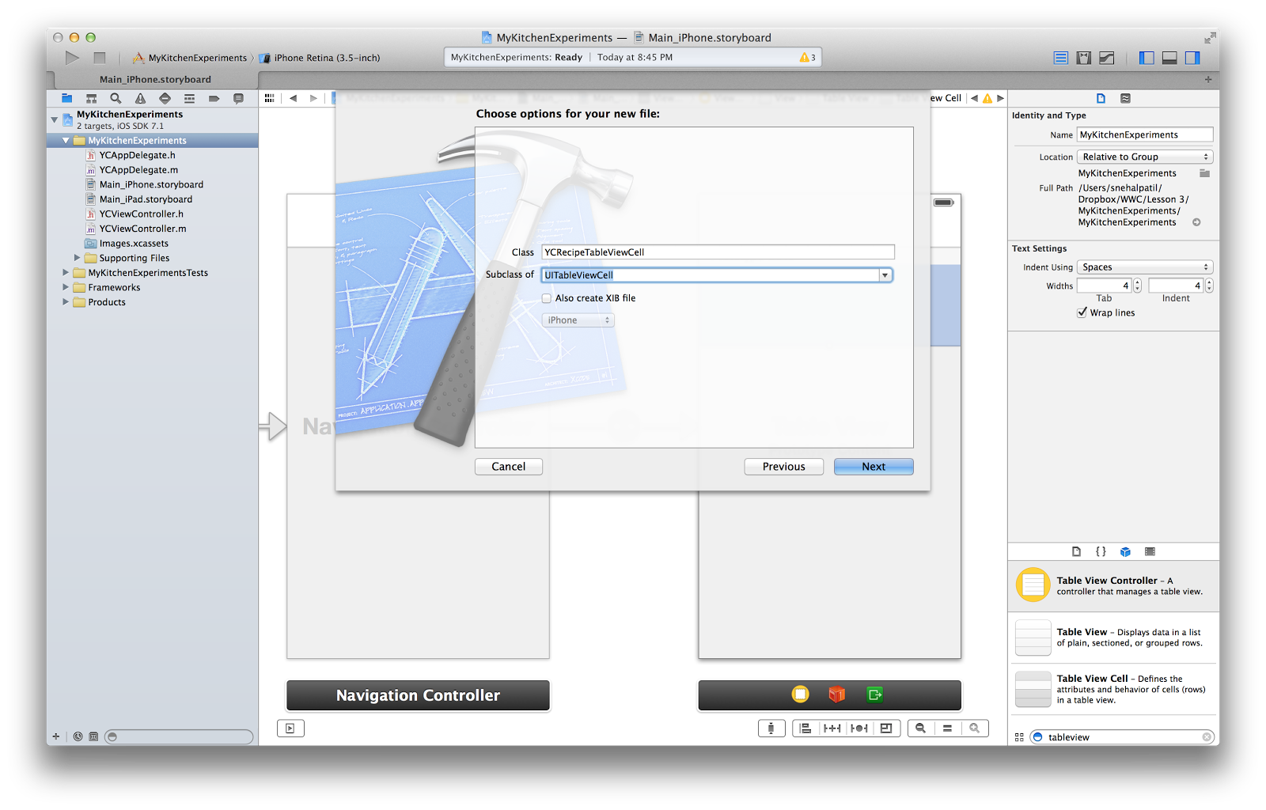
Add UITableViewCell

Slide 20
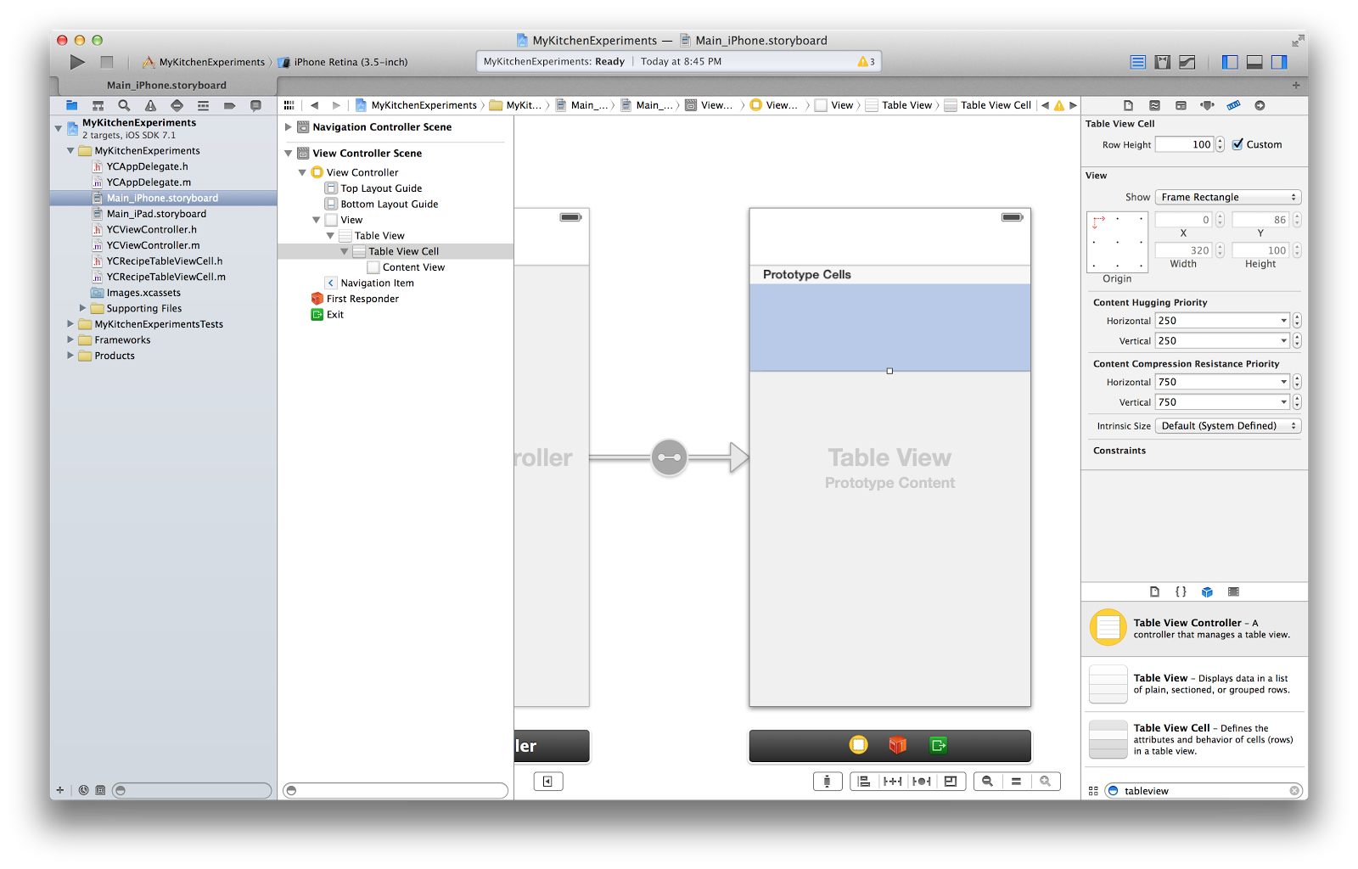
Add TableViewCell Class name

Slide 21
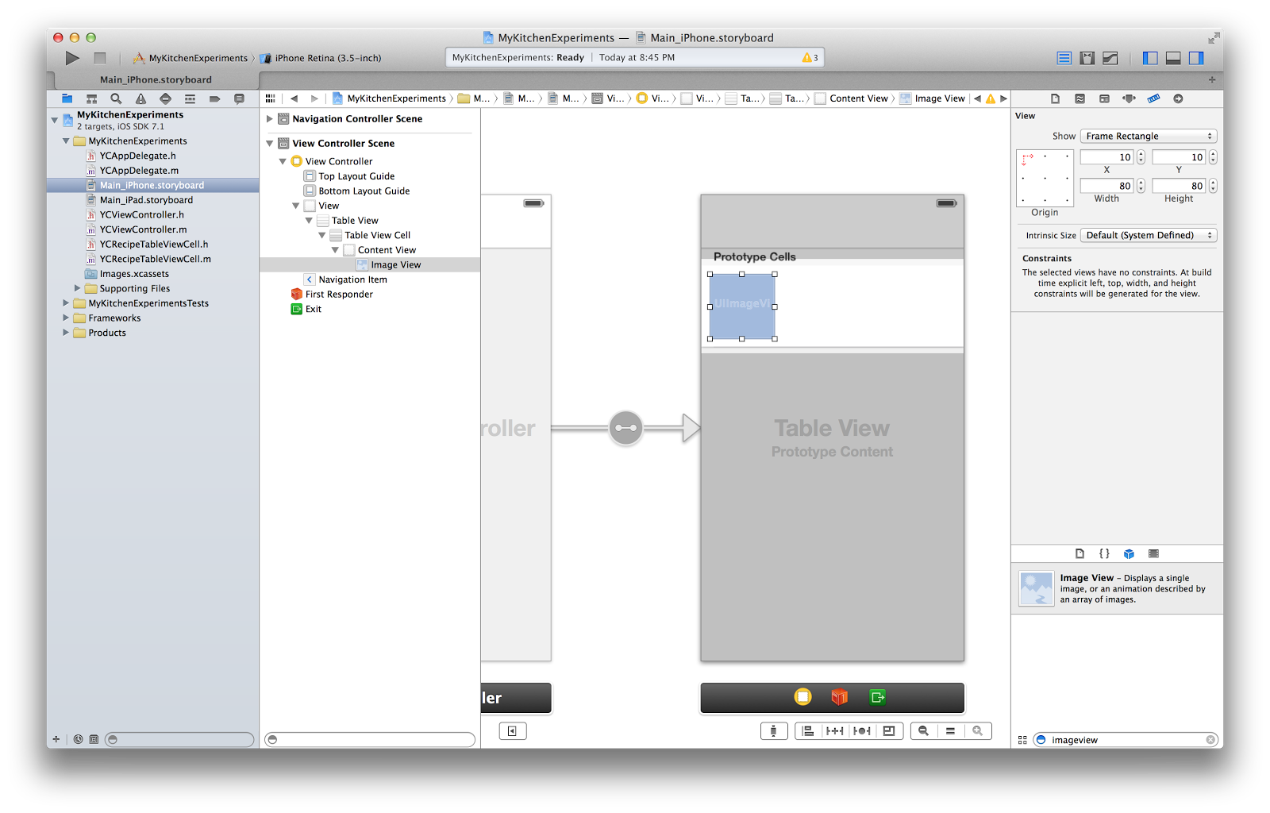
Add Imageview to tableviewcell

Slide 22
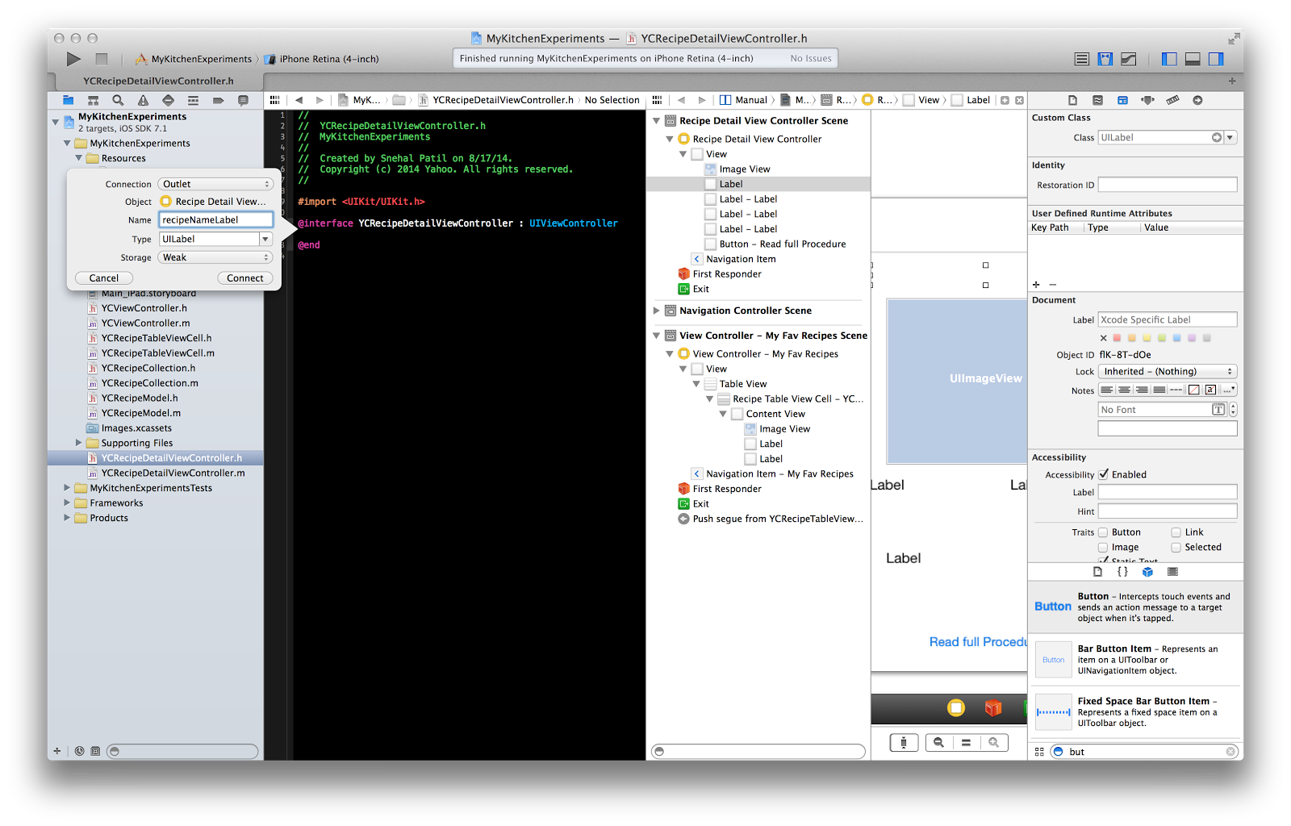
Add connections

Slide 23
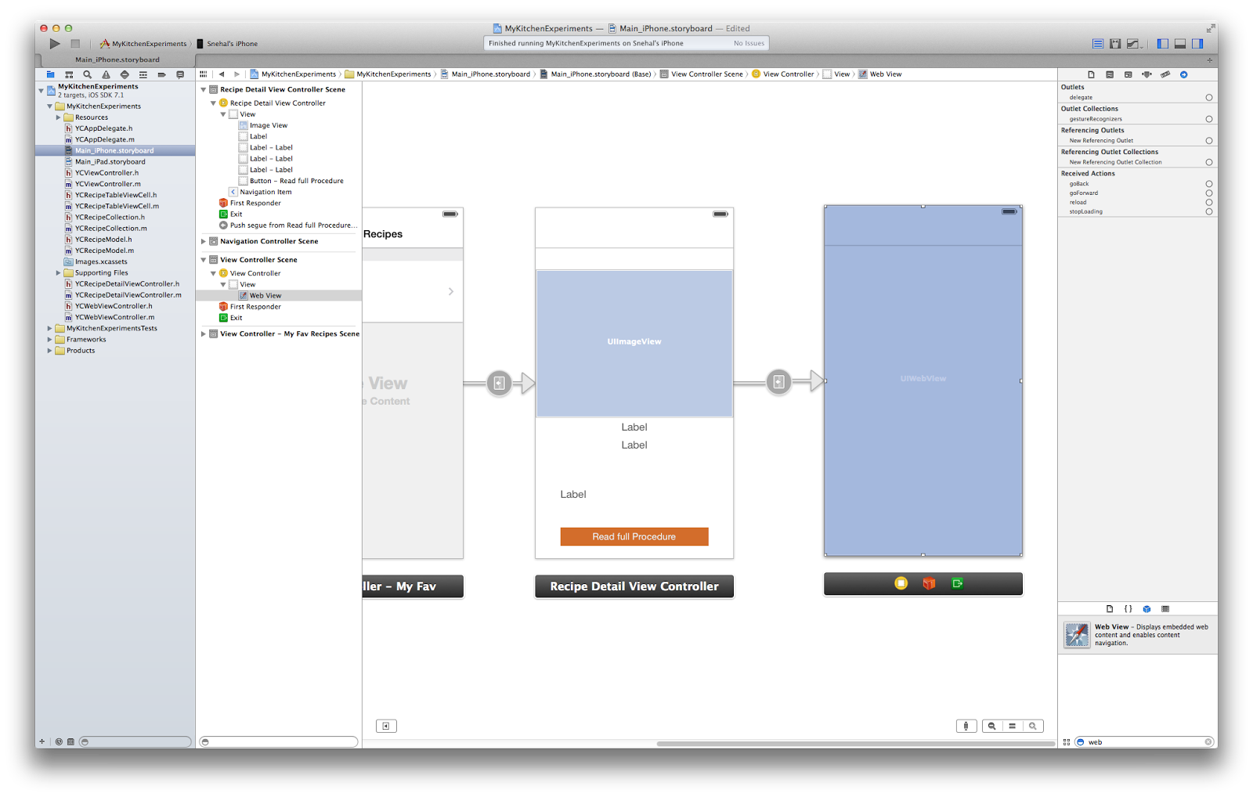
Add UIViewController and WebView

Slide 24
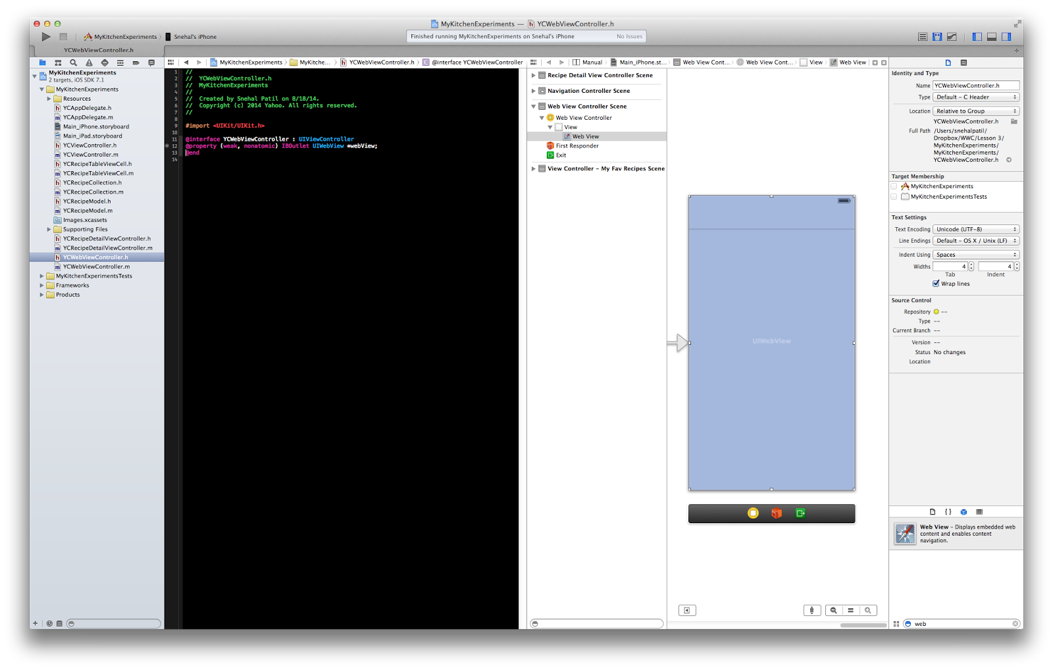
Connect UIWebView

Slide 25
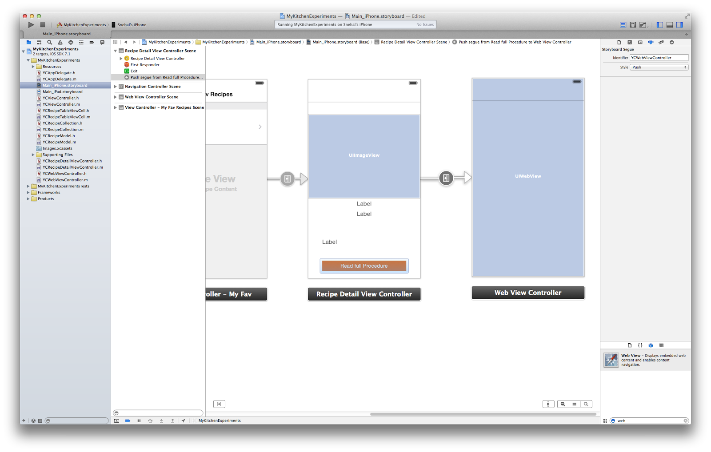
Segway for web view

Slide 26
Questions

Slide 27
Feedback

